Slide 1
CSCI 755: Artificial Intelligence
Creating a GAN to generate a realistic sound
Name: Mann Patel
NYIT ID: 1316627
Semester: Spring 2024

Slide 2
What is a GAN?
GAN stands for Generative Adversarial Network
Type of machine learning model that creates new data instances that resemble training data
Two components:
Generator – Creates new data instances
Discriminator – Analyzes the initial training data and distinguishes between them

Slide 3
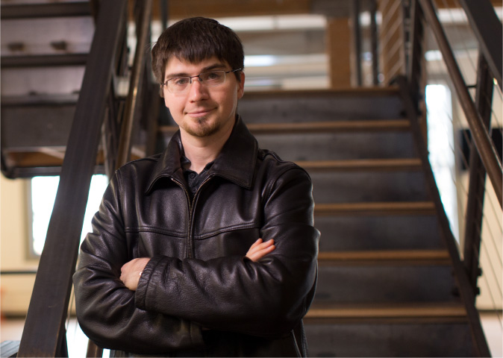
Who developed GAN?
GAN was initially developed by Ian Goodfellow and his colleagues in June 2014
Yann LeCun, the founding father of Convolutional Neural Networks (CNNs), described GANs as “the most interesting idea in the last ten years in Machine Learning“.

Slide 4
Some uses of GANs
Image Editing
Image-to-image translation
Text-to-image translation
Audio and/or video generation
3D object generation
Medical science imaging
Cartoon generation

Slide 5
Advantages and Disadvantages of GANs
Advantages:
Data Generation: GANs create realistic synthetic data.
Unsupervised Learning: They learn from unlabeled data.
Variety: GANs produce diverse outputs.
Creative Applications: Used for image editing, style transfer, and more.
Feature Learning: They learn rich data representations.
Disadvantages:
Mode Collapse: Limited sample diversity.
Training Instability: Difficult to optimize.
Evaluation Difficulty: Challenging to assess quality.
Computationally Intensive: Requires powerful hardware.
Ethical Concerns: Potential misuse for fake content.

Slide 6
Working of the GAN
Generator modifies some data attributes by adding noise, then passes it to the discriminator
Discriminator calculates the probability that the generated output belongs to the original dataset
It gives guidance to the generator to reduce noise vector randomization in the next cycle
Both compete with one another to generate authentic data

Slide 7
Mathematics behind GANs
Generator (G):
G takes random noise as input (usually a vector).
It has a function that transforms this noise into a data sample.
Mathematically, G is represented as G(z), where z is the input noise vector.
Discriminator (D):
D takes a data sample (real or generated) as input.
It evaluates the input and predicts whether it's real or fake.
Mathematically, D is represented as D(x), where x is the input data sample.
Training Process:
During training, G and D play a game against each other.
G tries to generate samples that are indistinguishable from real ones, while D aims to differentiate between real and fake samples.
This is formulated as a minimax game, where G tries to minimize the probability of D correctly classifying generated samples as fake, and D tries to maximize this probability.

Slide 8
Objective Function
Objective Function:
The objective is to find a balance where G generates samples that are realistic enough to fool D.
This is achieved by optimizing two separate loss functions:
Generator Loss: Measures how well G fools D. It encourages G to generate samples that D classifies as real.
Discriminator Loss: Measures how well D distinguishes between real and fake samples. It penalizes D for incorrectly classifying generated samples.
Training Algorithm:
During training, G and D are updated iteratively.
G is trained to minimize its loss by generating more realistic samples.
D is trained to minimize its loss by becoming better at distinguishing between real and fake samples.
This process continues until G generates samples that are sufficiently realistic to fool D.

Slide 9
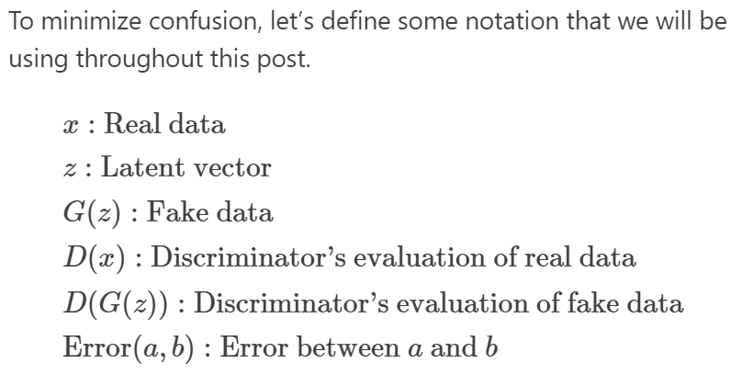
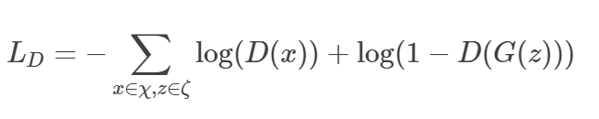
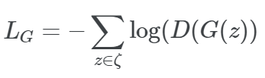



Loss Functions
Objective Function

Slide 10
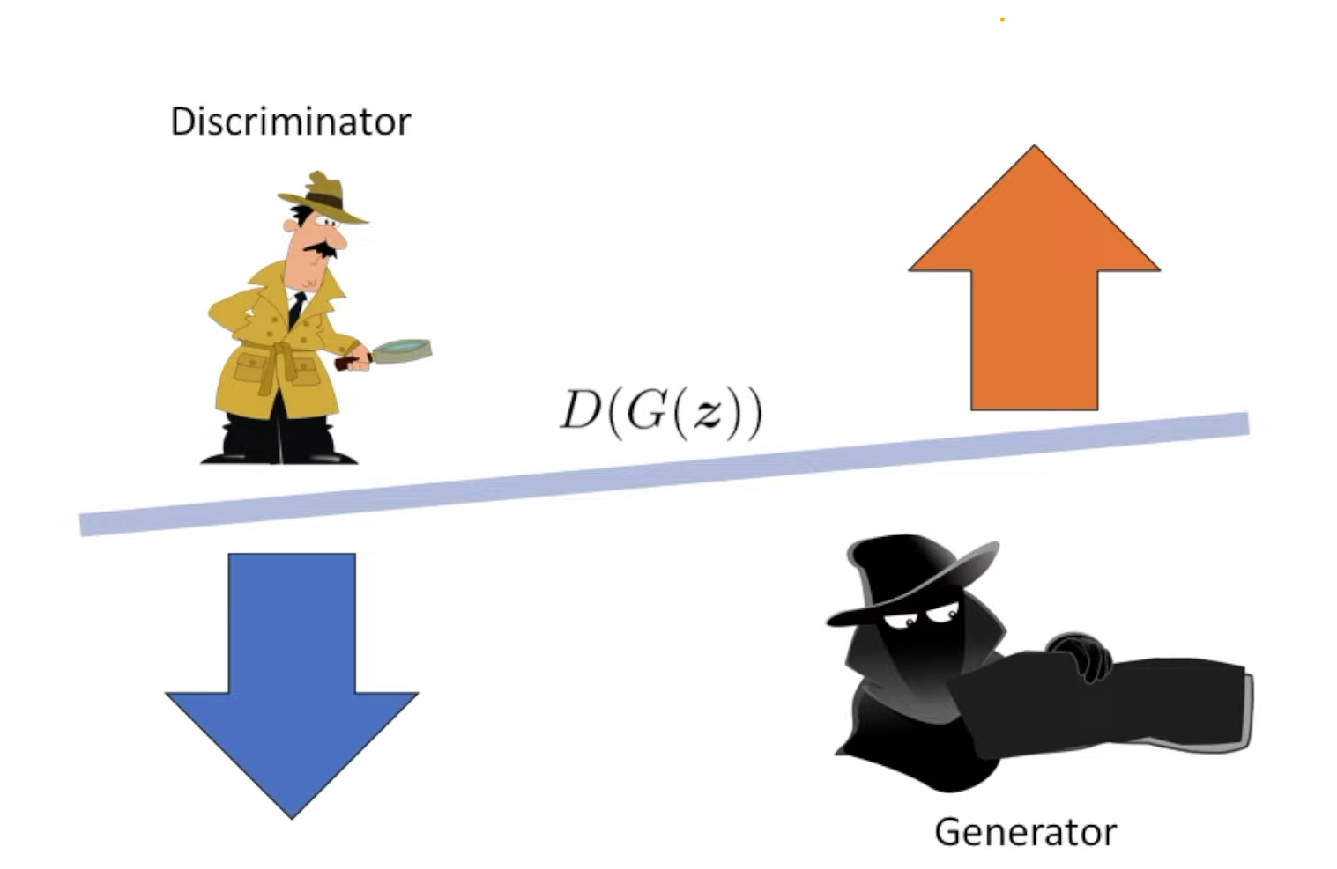
An illustration of the competition

Slide 11
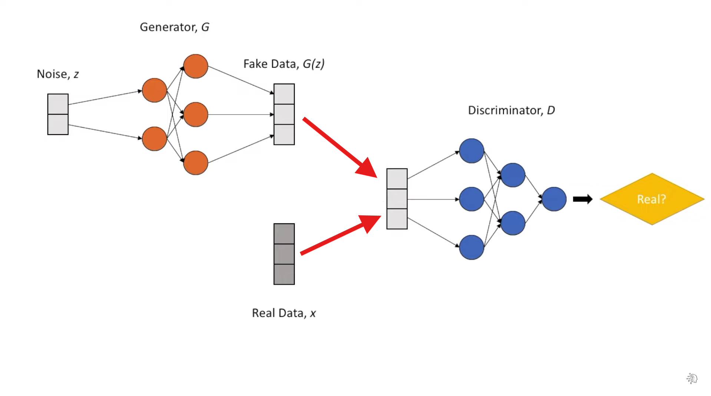
D(G(z))
D(x)

Slide 12
Creation of a bird sound using GAN
First, we use sample audio data of bird sounds as input of the program
We prepare the data by normalization and rescaling of data
Next, we design a generator to generate fake audio samples of bird sounds
Additionally, we also design a discriminator that distinguishes between our original audio files and the generated ones
Then comes the GAN wherein audio from the generator competes with the original audio until it can fool the discriminator
We train our model for a few Epochs (here 50 epochs) and with each epoch our model generates a better (close to original) audio
We also generate loss graphs for both generator and discriminator
Finally, we play our generated audio files after all epochs are done

Slide 13
References
https://neptune.ai/blog/gan-loss-functions
https://www.youtube.com/watch?v=TpMIssRdhco
https://www.youtube.com/watch?v=AALBGpLbj6Q&t=229s
https://www.kaggle.com/code/mrhippo/generating-bird-sound-with-simple-gans/notebook
https://www.google.com/imghp?hl=en-GB&tab=ri&authuser=0&ogbl
https://chatgpt.com/
https://jaketae.github.io/study/gan-math/
https://www.youtube.com/watch?v=J1aG12dLo4I

Slide 14
THANK YOU!

